Slide 1
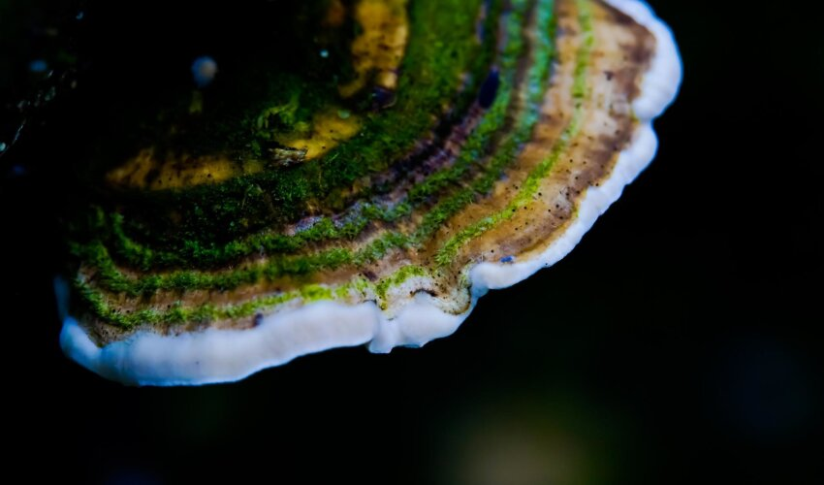
Data analysis on Mushrooms
Prabhu Kiran
Amrita Vishwa Vidyapeetham

Slide 2
Objectives
Visualization
Correlations
Hypothesis testing
Important features

Slide 3
Dataset
cap-shape: bell=b,conical=c,convex=x,flat=f, knobbed=k,sunken=s
cap-surface: fibrous=f,grooves=g,scaly=y,smooth=s
cap-color: brown=n,buff=b,cinnamon=c,gray=g,green=r, pink=p,purple=u,red=e,white=w,yellow=y
bruises?: bruises=t,no=f
odor: almond=a,anise=l,creosote=c,fishy=y,foul=f, musty=m,none=n,pungent=p,spicy=s
gill-attachment: attached=a,descending=d,free=f,notched=n
gill-spacing: close=c,crowded=w,distant=d
gill-size: broad=b,narrow=n
gill-color: black=k,brown=n,buff=b,chocolate=h,gray=g, green=r, orange=o,pink=p,purple=u,red=e, white=w,yellow=y
stalk-shape: enlarging=e,tapering=t
stalk-root: bulbous=b,club=c,cup=u,equal=e, rhizomorphs=z,rooted=r,missing=?
stalk-surface-above-ring: fibrous=f,scaly=y,silky=k,smooth=s

Slide 4
Dataset
stalk-surface-below-ring: fibrous=f,scaly=y,silky=k,smooth=s
stalk-color-above-ring: brown=n,buff=b,cinnamon=c,gray=g,orange=o, pink=p,red=e,white=w,yellow=y
stalk-color-below-ring: brown=n,buff=b,cinnamon=c,gray=g,orange=o, pink=p,red=e,white=w,yellow=y
veil-type: partial=p,universal=u
veil-color: brown=n,orange=o,white=w,yellow=y
ring-number: none=n,one=o,two=t
ring-type: cobwebby=c,evanescent=e,flaring=f,large=l, none=n,pendant=p,sheathing=s,zone=z
spore-print-color: black=k,brown=n,buff=b,chocolate=h,green=r, orange=o,purple=u,white=w,yellow=y
population: abundant=a,clustered=c,numerous=n, scattered=s, several=v,solitary=y
habitat: grasses=g,leaves=l,meadows=m,paths=p, urban=u,waste=w,woods=d

Slide 5
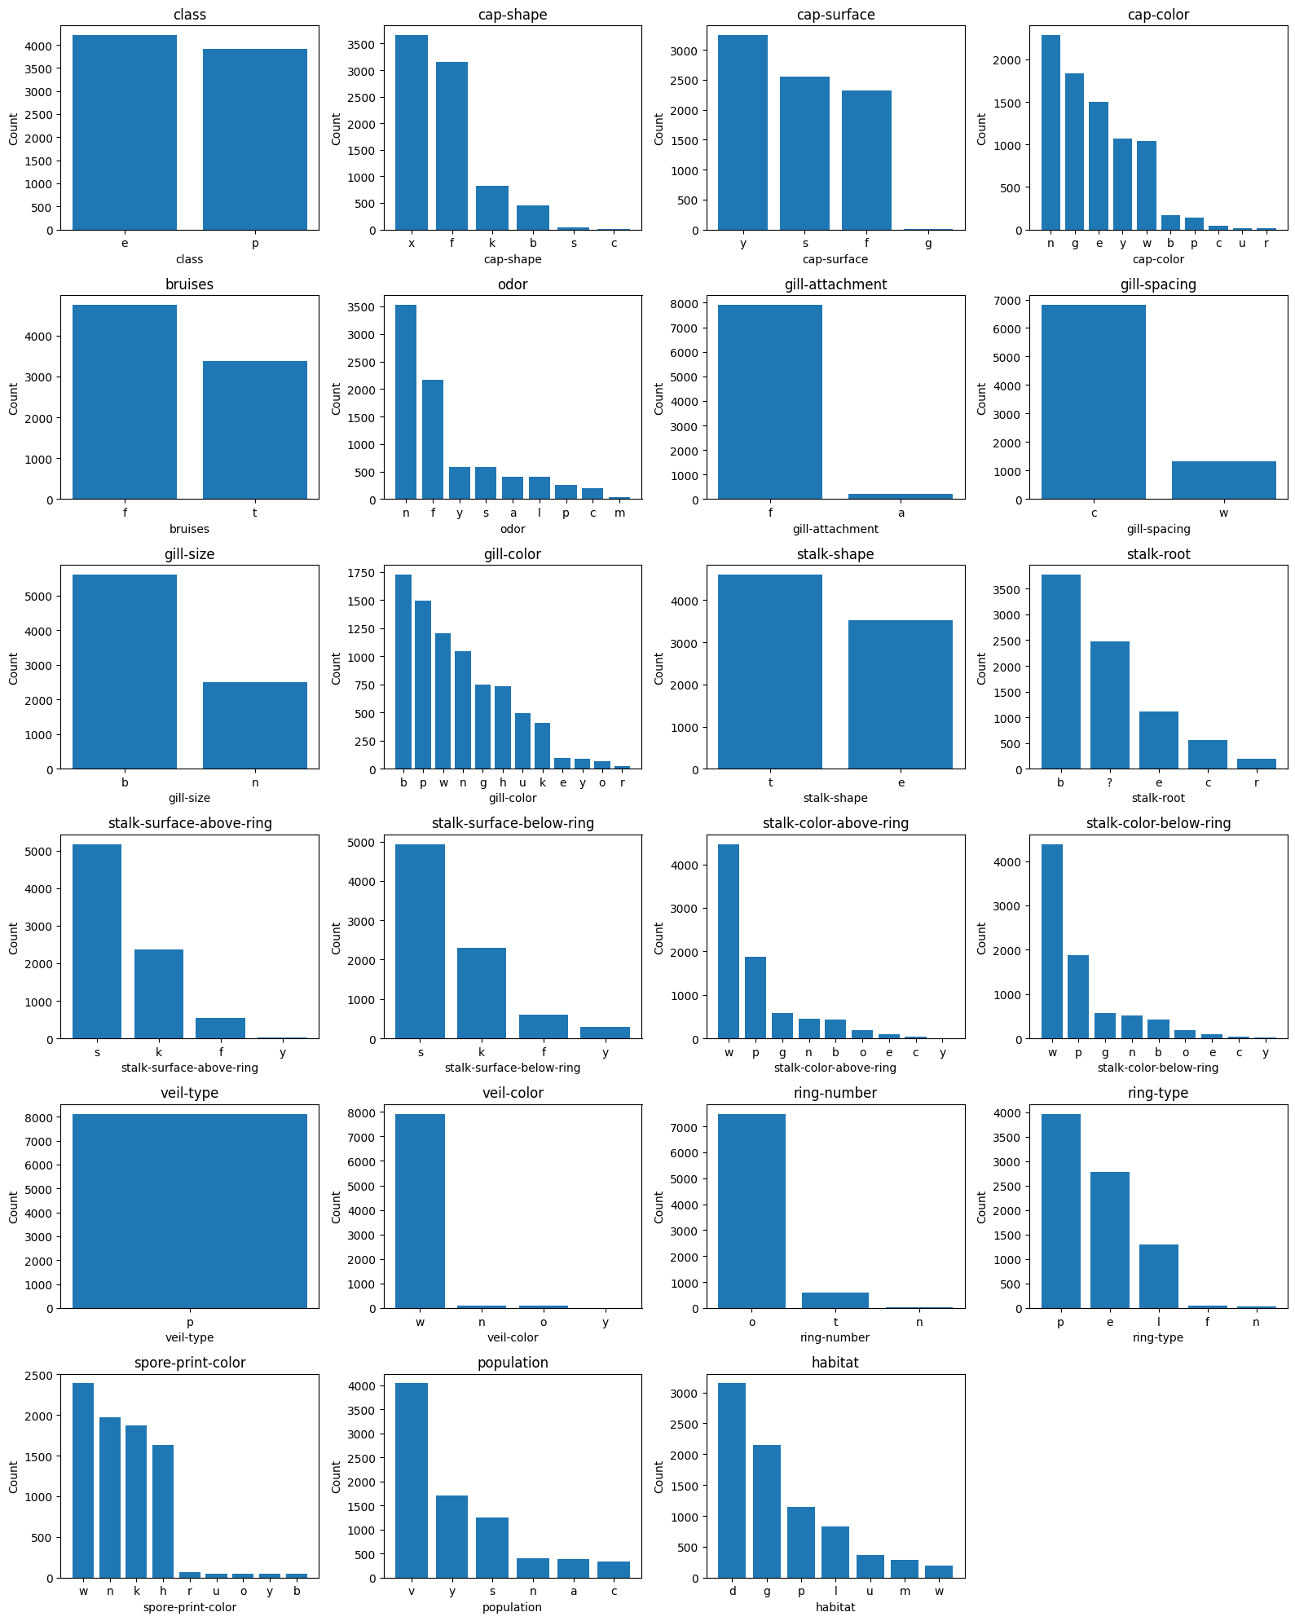

Slide 7
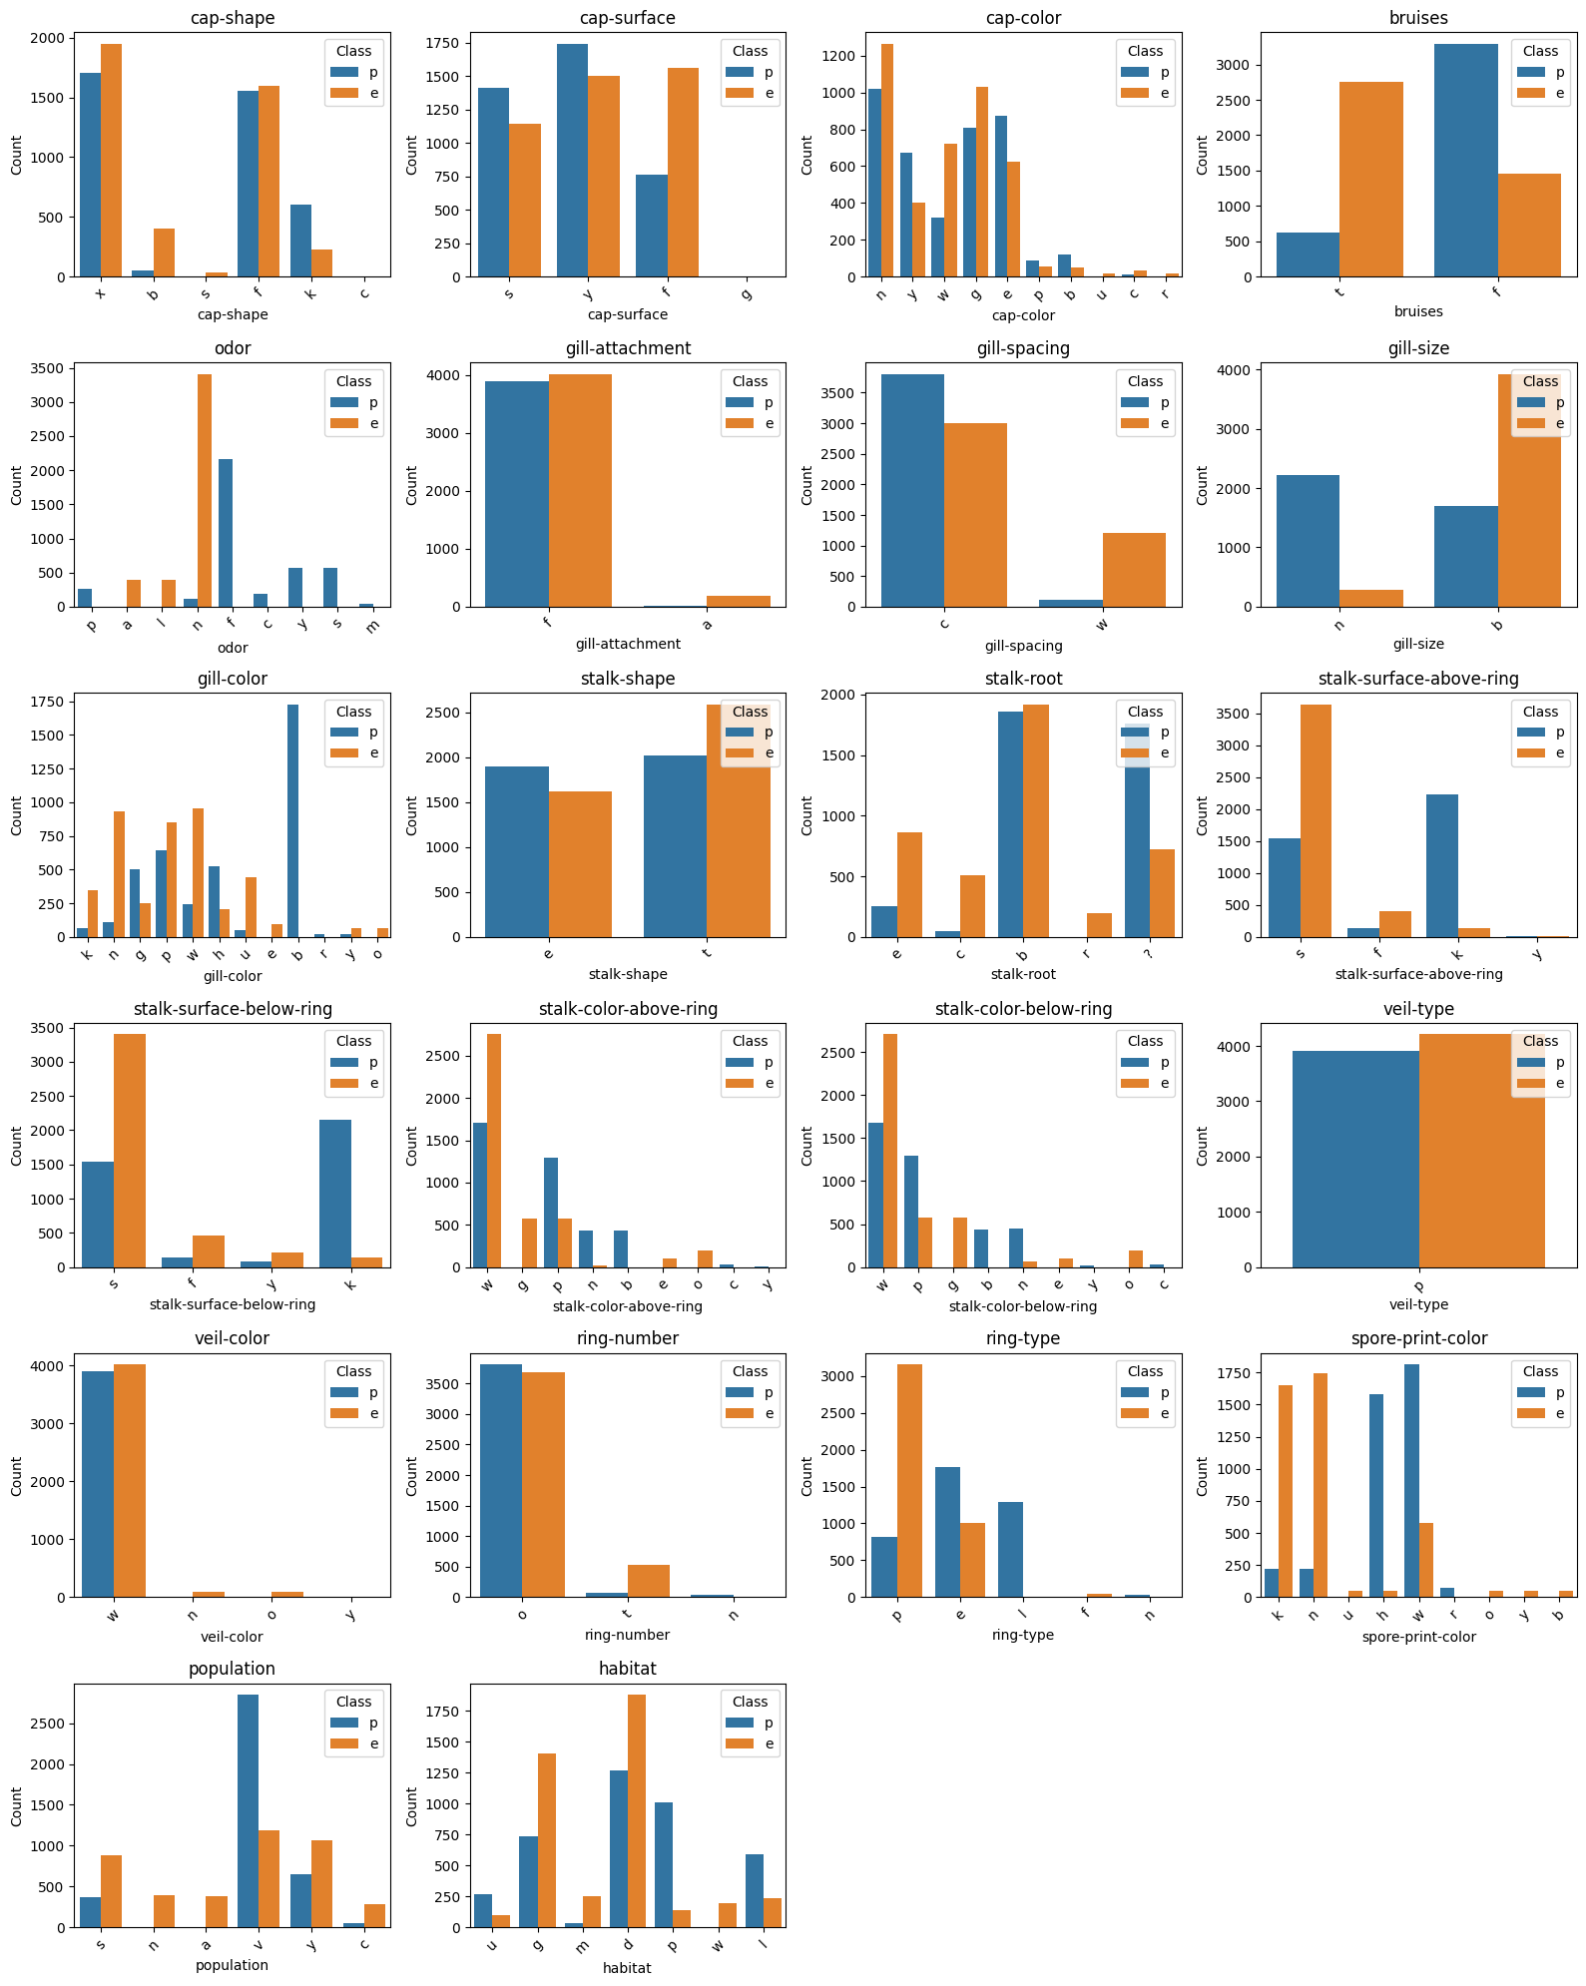

Slide 9
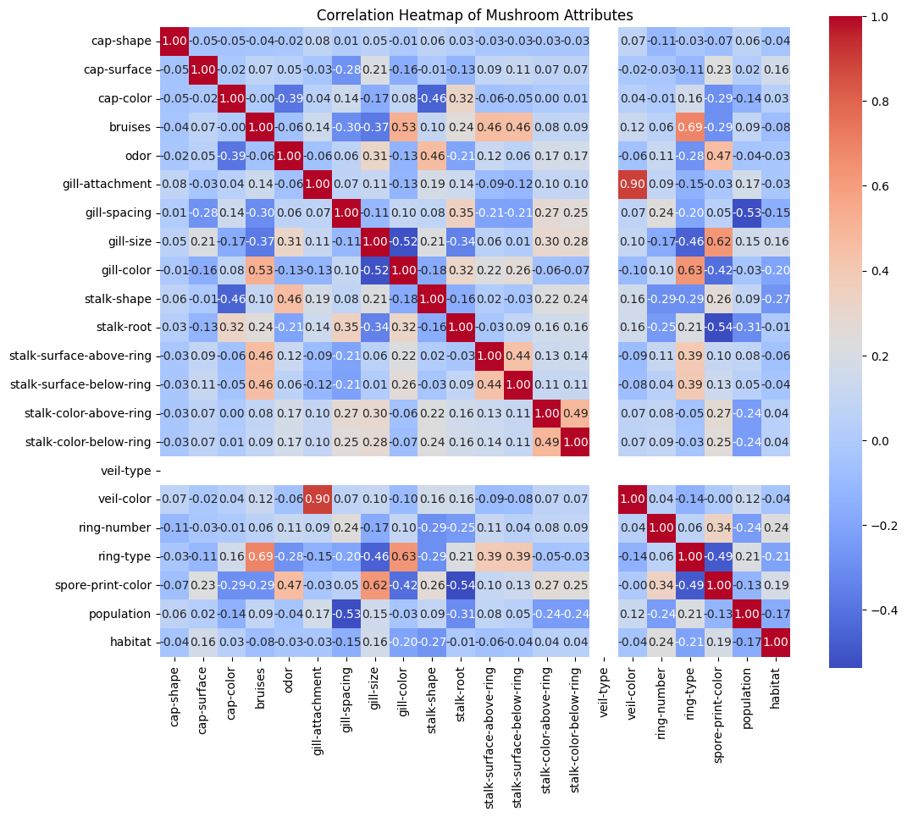
Coefficient: Range -1 to 1.
Blue: Negative correlation
When one attribute is present, the other tends to be absent.
Red: Positive correlation
When one attribute is present, the other tends to be present.
0 → no correlation.
-1 → perfect negative correlation
1 → perfect positive correlation

Slide 10
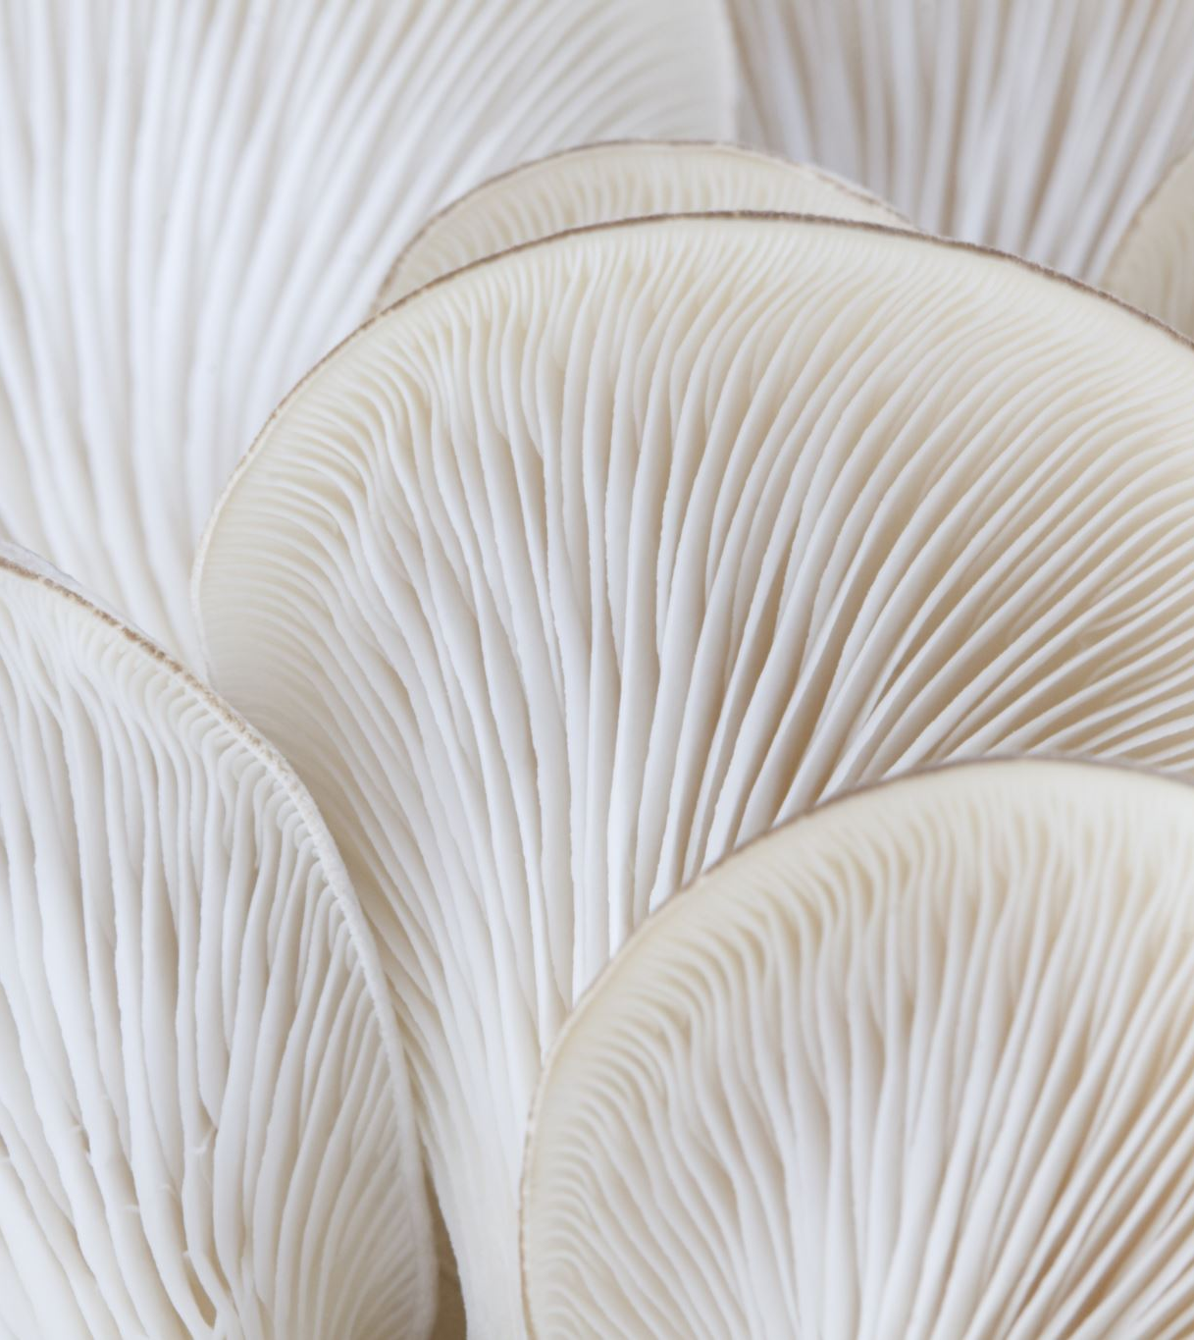
Hypothesis Testing
Null Hypothesis (H0): The cap shape of mushrooms has no effect on their edibility. The distribution of edible and poisonous mushrooms is the same across different cap shapes.
Alternative Hypothesis (H1): The cap shape of mushrooms has an effect on their edibility. The distribution of edible and poisonous mushrooms differs significantly across different cap shapes.

Slide 11
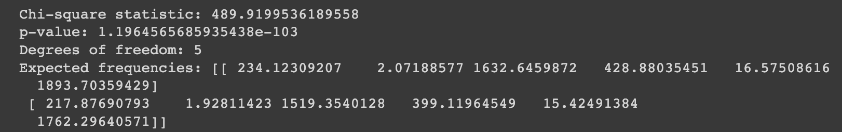
Chi-square statistic : 489.92
p-value : 1.20e-103.
Degrees of freedom : 5
→Significant deviation from the expected frequencies.
→Extremely small p-value suggests strong evidence against the null hypothesis
Reject null hypothesis;
Cap shape of mushrooms has an effect on their edibility.

Slide 12
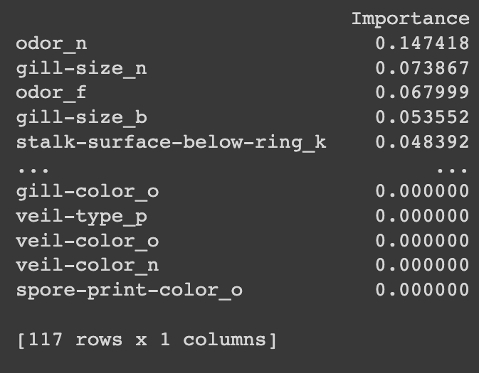
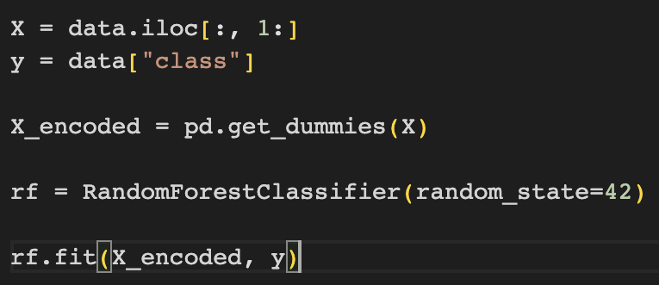
Encoding Categorical features and Creating Random Forest classifier

Slide 13
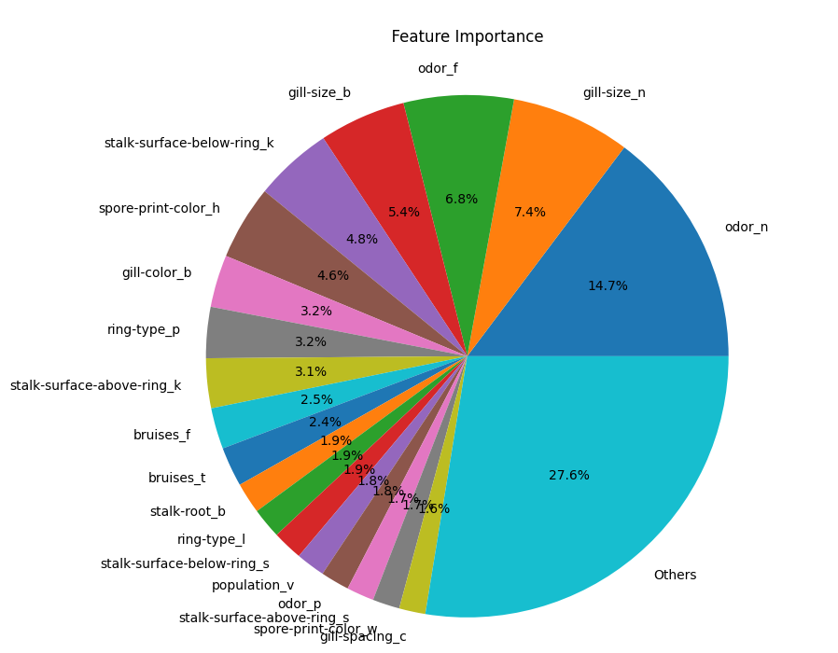

Slide 14
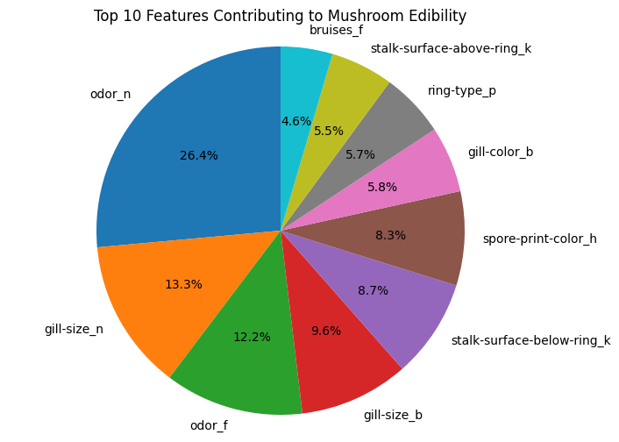

Slide 15
Conclusion
Insights:
→Data exploration
→Visualization of Attribute distributions and relationships
→Identification of influential features
Findings :
→Odor, spore print color, stalk surface above ring, and cap shape play vital roles in differentiating edibility

